Slide 1
Topic: Rounding Decimals
EQ: How do I round decimals to a given number of places?

Slide 2
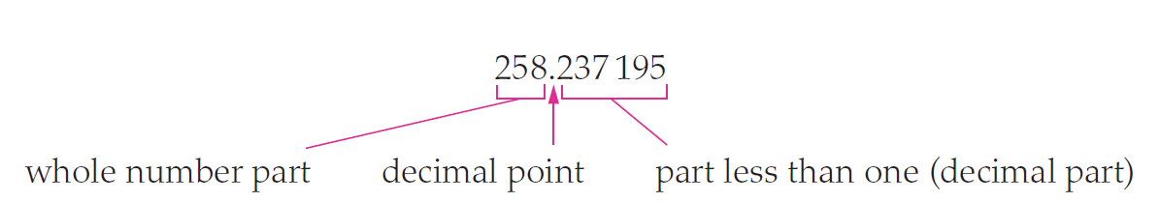
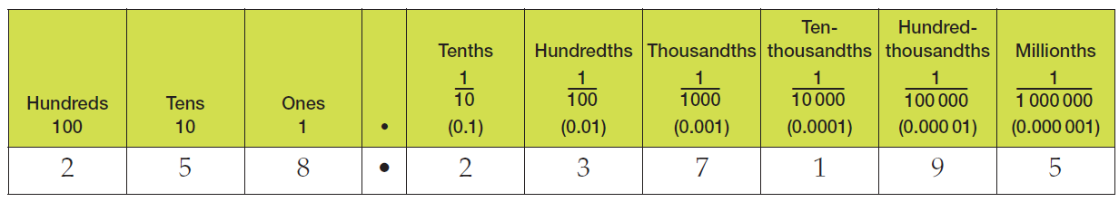
Topic: Rounding Decimals
EQ: How do I round decimals to a given number of places?
What is a decimal?
Decimals and place value?

Slide 3
Topic: Rounding Decimals
EQ: How do I round decimals to a given number of places?
Why is this important?
If you are asked to round a number to the nearest hundredth, knowing your place value vocabulary will ensure that you know that means 2 decimal places

Slide 4
Left-Hand-Side Task 1
3 Minutes
If you are asked to round to the following, how many decimal points will there be?
  Tenth
  Millionth
  Thousandth
  Hundred Thousandth
  Hundredth
1
6
3
5
2

Slide 5
Topic: Rounding Decimals
EQ: How do I round decimals to a given number of places?
Step 1
Determine the number of decimal places that you are required to round to.
Step 2
Look at the next digit to the right of the one that you are rounding to. If the digit is:
  Less than 5, then leave the digit being considered as is and delete all digits after it
  5 or greater, then increase the digit being considered by one and delete all digits after it.
Method?

Slide 6
Topic: Rounding Decimals
EQ: How do I round decimals to a given number of places?
2 decimal places
Less than 5 → Stays the same
5 or greater → Round up
EG//
Round 3.4568 to the nearest hundredth
One | Decimal point | Tenth | Hundredth | Thousandth | Ten Thousandth
3 | ● | 4 | 5 | 6 | 8
3.46

Slide 7
Left-Hand-Side Task 2
4 Minutes
Check your answers!
Round the following to the nearest tenth:
  926.73
  7.492
  50.04267
Round the following to the nearest thousandth:
  12.9352
  0.002451
  200.4829721
926.7
7.5
50.0
12.935
0.002
200.483

Slide 8

Topic: Rounding Decimals
EQ: How do I round decimals to a given number of places?
Real life application?
Money!

Slide 9
Topic: Rounding Decimals
EQ: How do I round decimals to a given number of places?
Real life application?
We write money using decimal notation, usually with 2 decimal places

Slide 10
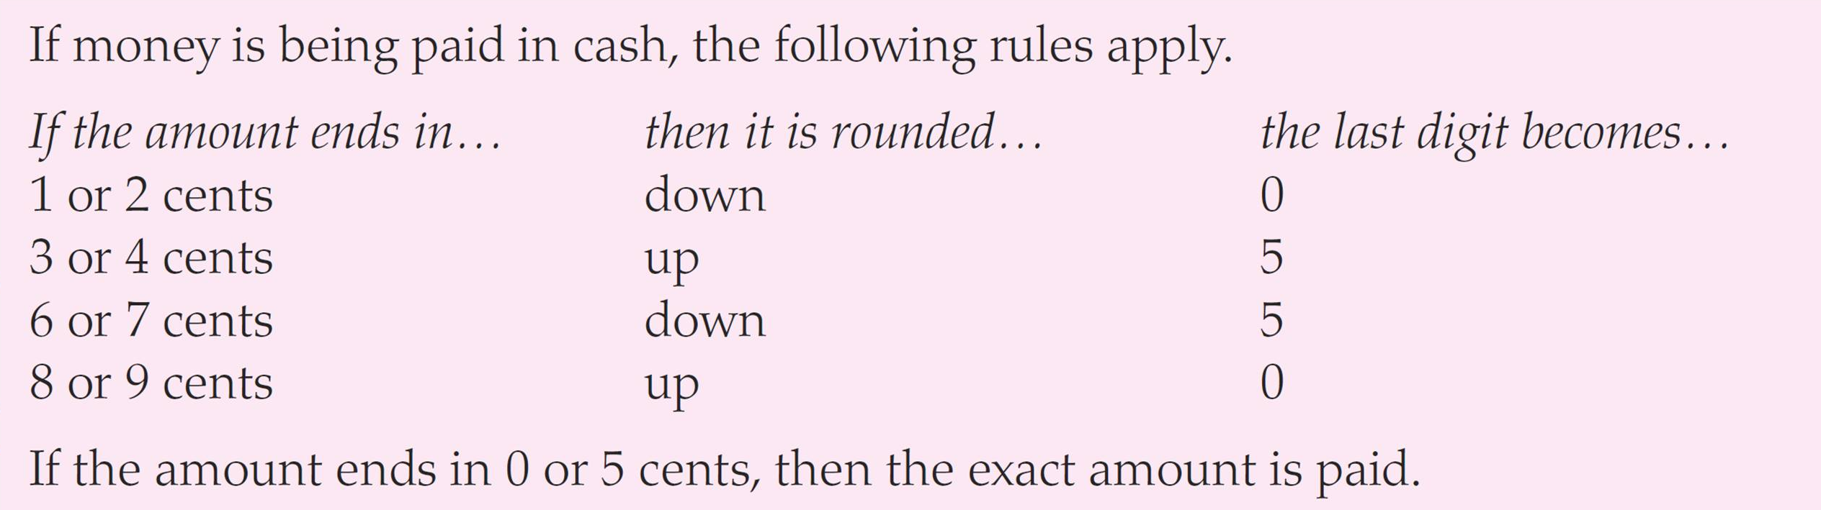
Topic: Rounding Decimals
EQ: How do I round decimals to a given number of places?
Real life application?
We write money using decimal notation, usually with 2 decimal places

Slide 11
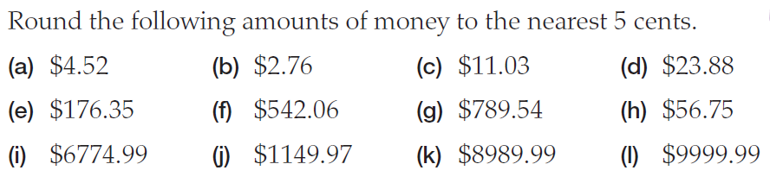
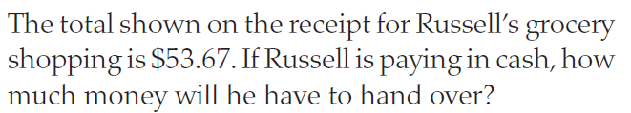
Left-Hand-Side Task 3

Slide 12
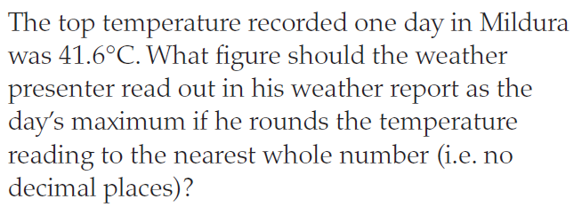

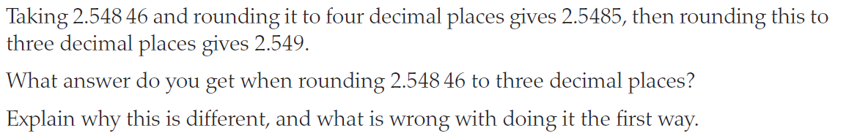
Challenge Questions!

